Slide 1
WIRELESS NETWORK SECURITY
Mahendra Pratap Singh
Assistant Professor

Slide 2
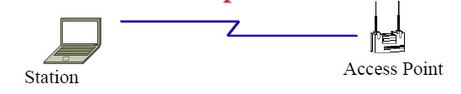
WI-FI
Access Points (APs) periodically broadcast a beacon with SSID (service set ID) and security level.
SSID is used to differentiate one access point from another.
Subscriber stations listen to these beacons, measure signal strength and determine which AP to join.
Subscribers can also send a “Probe” to find AP’s in the neighbourhood.
AP authenticates the subscriber station using following methods.

Slide 3
802.11B: BUILT IN SECURITY FEATURES
Service Set Identifier (SSID)
Differentiates one access point from another
SSID is cast in ‘beacon frames’ every few seconds.
Beacon frames are in plain text!

Slide 4
MAC ADDRESS FILTERING
Access Point contains MAC addresses of user NICs (Network Interface Cards).
Prevents from casual guests logging into the wireless network.
Problem:
    Easy to find good MAC addresses by sniffing and then address spoofing.

Slide 5
ASSOCIATING WITH THE AP
Access points have two ways of initiating communication with a client.
Shared Key or Open System authentication.
Open System: need to supply the correct SSID.
      Allow anyone to start a conversation with the AP.
Shared Key is supposed to add an extra layer of security by requiring authentication info as soon as one associates.

Slide 6
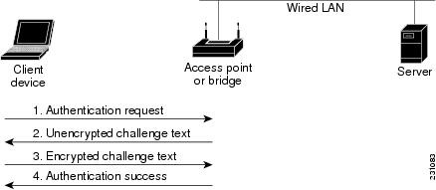
HOW SHARED KEY AUTH. WORKS
Client begins by sending an association request to the AP.
AP responds with a challenge text (unencrypted).
Client, using the proper WEP key, encrypts text and sends it back to the AP.
If properly encrypted, AP allows communication with the client.

Slide 7
WIRED EQUIVALENT PROTOCOL (WEP)
Primary built security for 802.11 protocol.
Intended to make wireless as secure as a wired network.
First encryption standard for wireless. Defined in 802.11b
Provides authentication and encryption.
Shared Key Authentication.
⇒ Single key is shared by all users and access points

Slide 8
WEP
Two modes of authentication: Open system and Shared Key.
Shared Key: Challenge-response verifies client has the key.
Manual key distribution.
If an adapter or AP is lost, all devices must be re-keyed.
Unfortunately, since ratification of the 802.11 standard, RC4 has been proven insecure, leaving the 802.11 protocol wide open for attack.

Slide 9
WEP KEYS
Default Key:
Also known as shared key, group key, multicast key, broadcast key. 40-bit or 104 bit. Static.
Key mapping key:
Also known as individual key, per-station key, unique key. Access points need to keep a table of keys. Not generally implemented.
To allow smooth change over, two default keys are required (old and new).
WEP allows 4 default keys. Keys are numbered 0..3.
⇒ Can use different keys in two directions.

Slide 10
WEP KEYS
Base key is combined with a 24-bit initialization vector (IV).
⇒ Different key for each packet.
WEP does not specify how to select IV.
Many vendors generate random IV.

Slide 11
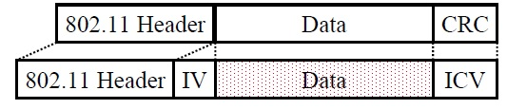
WEP DETAILS
Each device has 4 static WEP keys.
2-bit key ID sent w Initialization Vector (IV) in clear in each packet.
Per-Packet encryption key =24-bit IV + one of pre-shared key.
Encryption Algorithm: RC4
      Standard: 24 + 40 = 64-bit RC4 Key
      Enhanced: 24 + 104 = 128 bit RC4 key
WEP allows IV to be reused.
CRC-32 = Integrity Check Value (ICV)
Data and ICV are encrypted under per-packet encryption key.

Slide 12
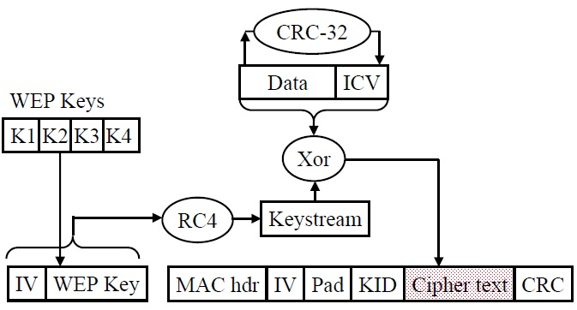
WEP ENCRYPTION

Slide 13
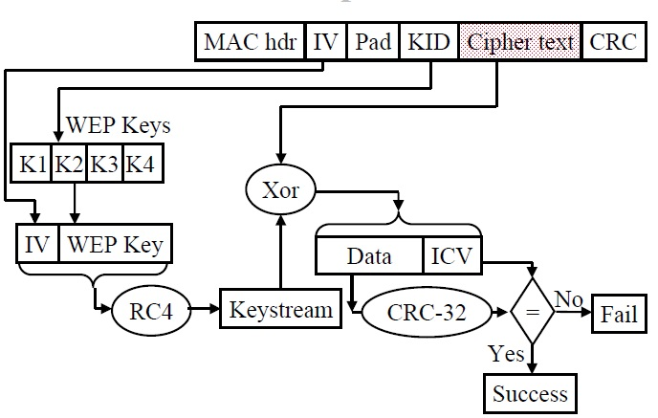
WEP DECRYPRTION

Slide 14
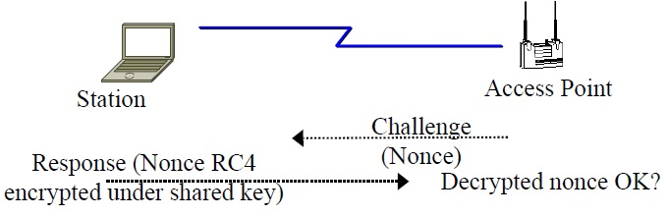
WEP AUTHENTICATION
Authentication is a via Challenge response using RC4 with the shared secret key.

Slide 15
PROBLEM WITH WEP AUTHENTICATION
Record one challenge/response.
Both plain text and encrypted text are available to attacker.
XOR the two to get the keystream.
Use that keystream and IV to encrypt any subsequent challenges.

Slide 16
PROBLEM WITH STREAM CIPHER
Consider two packets with the same IV ⇒ Same keystream b.
c1 = p1 ⊕ b; c2 = p2 ⊕ b ⇒ c1 ⊕ c2=p1 ⊕ p2.
Two packets w same IV ⇒ XOR = Difference in plain text.
50% chance of using the same IV in 4823 packets.
Recovered ICV matches ⇒ Plain text is correct.
Possible to recover all 224 keystreams in a few hours.

Slide 17
PROBLEMS WITH WEP ICV
CRC is used as ICV
CRC: Message polynomial is shifted and divided by CRC polynomial, the remainder is sent as CRC
p = pnxn + pn–1xn–1 + … + p0x0
Remainder(p+q, c)
= Remainder(p, c) + Remainder(q, c)
ICV is linear: ICV(p+q) = ICV(p) + ICV(q)
Conclusion:
XOR any CRC-32 valid plain text to encrypted packet. The modified packet will pass the ICV after decryption.

Slide 18
MORE PROBLEMS WITH WEP
No centralized key management
Manual key distribution ⇒ Difficult to change keys
Single set of Keys shared by all ⇒ Frequent changes necessary
No mutual authentication
No user management (no use of RADIUS)
IV value is too short. Not protected from reuse.
Weak integrity check.
Directly uses master key
No protection against replay

Slide 19
WI-FI PROTECTED ACCESS (WPA)
Flaws in WEP known since January 2001 - flaws include weak encryption (keys no longer than 40 bits), static encryption keys, lack of key distribution method.
In April 2003, the Wi-Fi Alliance introduced an interoperable security protocol known as WiFi Protected Access (WPA).
WPA was designed to be a replacement for WEP networks without requiring hardware replacements.
WPA provides stronger data encryption (weak in WEP) and user authentication (largely missing in WEP).

Slide 20
WPA SECURITY ENHANCEMENTS
WPA includes Temporal Key Integrity Protocol (TKIP) and 802.1x mechanisms.
The combination of these two mechanisms provides dynamic key encryption and mutual authentication.
TKIP adds the following strengths to WEP:
  Per-packet key construction and distribution:
WPA automatically generates a new unique encryption key periodically for each client. This avoids the same key staying in use for weeks or months as they do with WEP.
  Message integrity code: guard against forgery attacks.
  48-bit initialization vectors, use one-way hash function instead of XOR

Slide 21
IEEE 802.11I SECURITY ENHANCEMENT
Strong message integrity check
􀂉 Longer Initialization Vector (48 bits in place of 24b)
􀂉 Key mixing algorithm to generate new per-packet keys
􀂉 Packet sequence number to prevent replay
􀂉 Extensible Authentication Protocol (EAP)
⇒ Many authentication methods. Default=IAKERB
􀂉 802.1X Authentication with Pre-shared key mode or managed mode with using RADIUS servers
􀂉

Slide 22
IEEE 802.11I SECURITY ENHANCEMENT
Mutual Authentication (Station-Key Distribution Center, Station-Access Point)
􀂉 AP sends security options in probe response if requested
􀂉 Robust Security Network (RSN)
⇒ Stronger AES encryption (AES-CCMP)

Slide 23
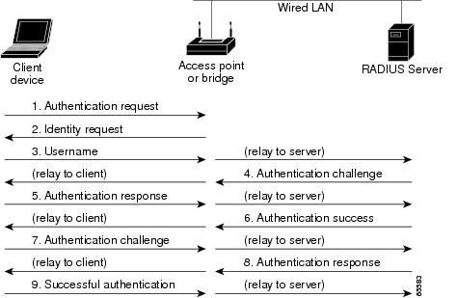
EAP

Slide 24


Slide 27
WPA2
In July 2004, the IEEE approved the full IEEE 802.11i specification, which was quickly followed by a new interoperability testing certification from the WiFi Alliance known as WPA2.
Strong encryption and authentication for infrastructure and ad-hoc networks (WPA1 is limited to infrastructure networks)
  Use AES instead of RC4 for encryption
WPA2 certification has become mandatory for all new equipment certified by the Wi-Fi Alliance, ensuring that any reasonably modern hardware will support both WPA1 and WPA2.

Slide 28
REFERENCES
https://www.cisco.com/c/en/us/td/docs/routers/access/wireless/software/guide/SecurityAuthenticationTypes.html#wp1035025
https://www.geeksforgeeks.org/wifi-protected-access-wpa/

